Slide 1
Air Masses

Slide 2
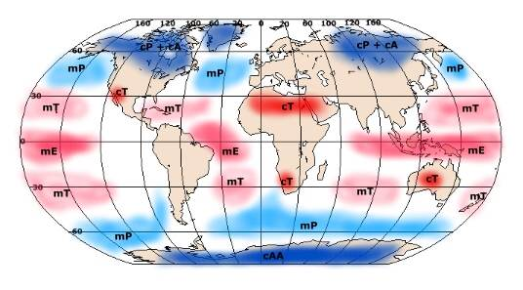
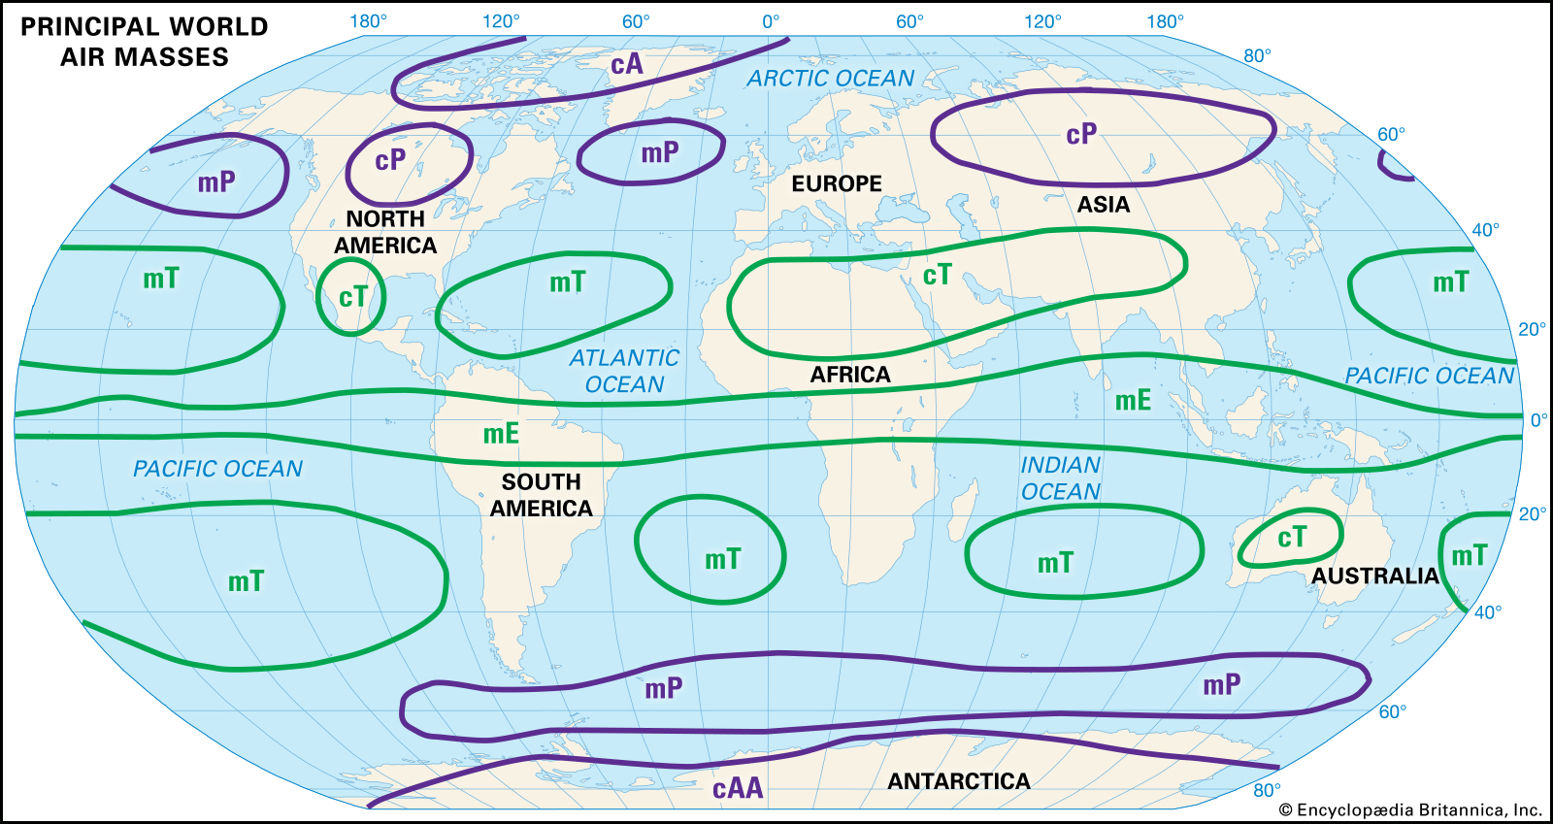
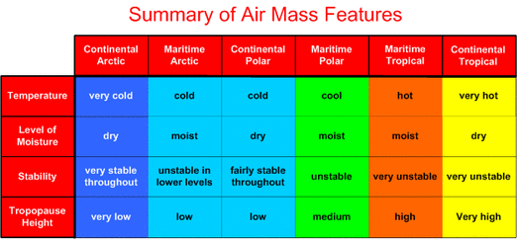
What is an Air Mass?
The atmosphere is made up of large air masses, which have relatively uniform temperature and moisture characteristics based on their geographical location.
Air masses have different names so we can tell where they are located and their specific characteristics!

Slide 3
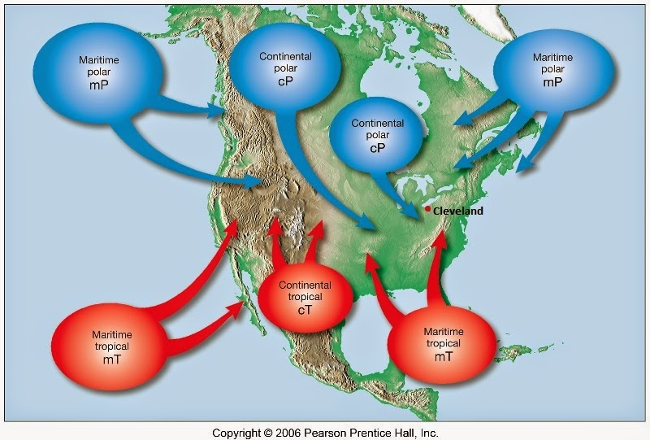
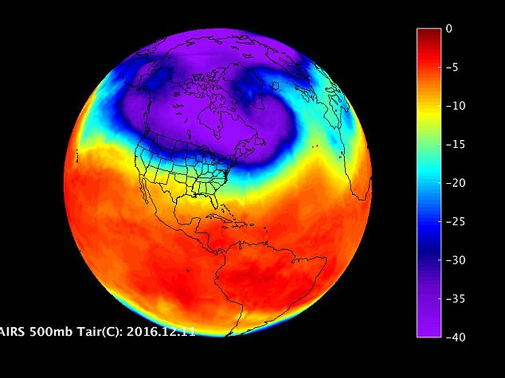
Air Mass Descriptions
Air masses are described based on their general characteristics:
Continental (dry) vs. Maritime (moist)
Polar (cold) vs. Tropical (warm)

Slide 4
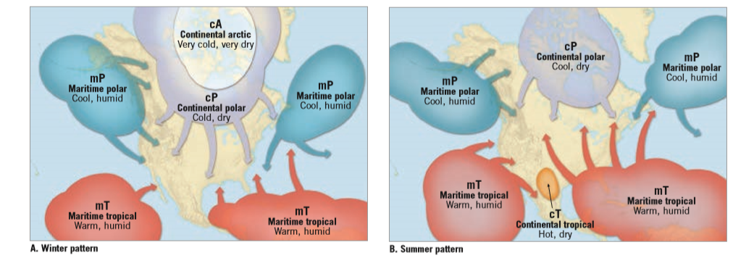
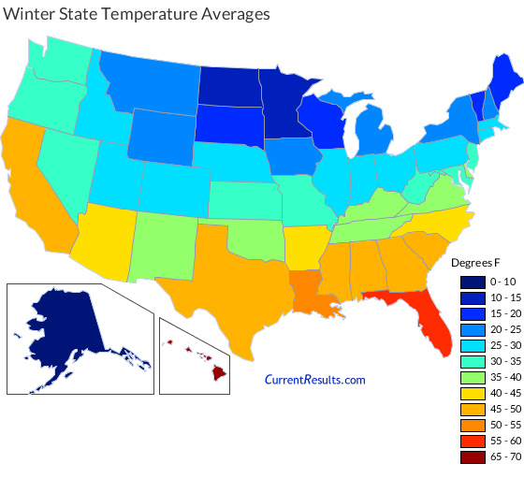
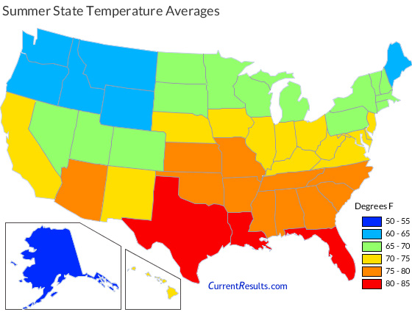
Seasons and Climate
The type and location of air masses changes by season, which helps define the climate of a location.

Slide 5
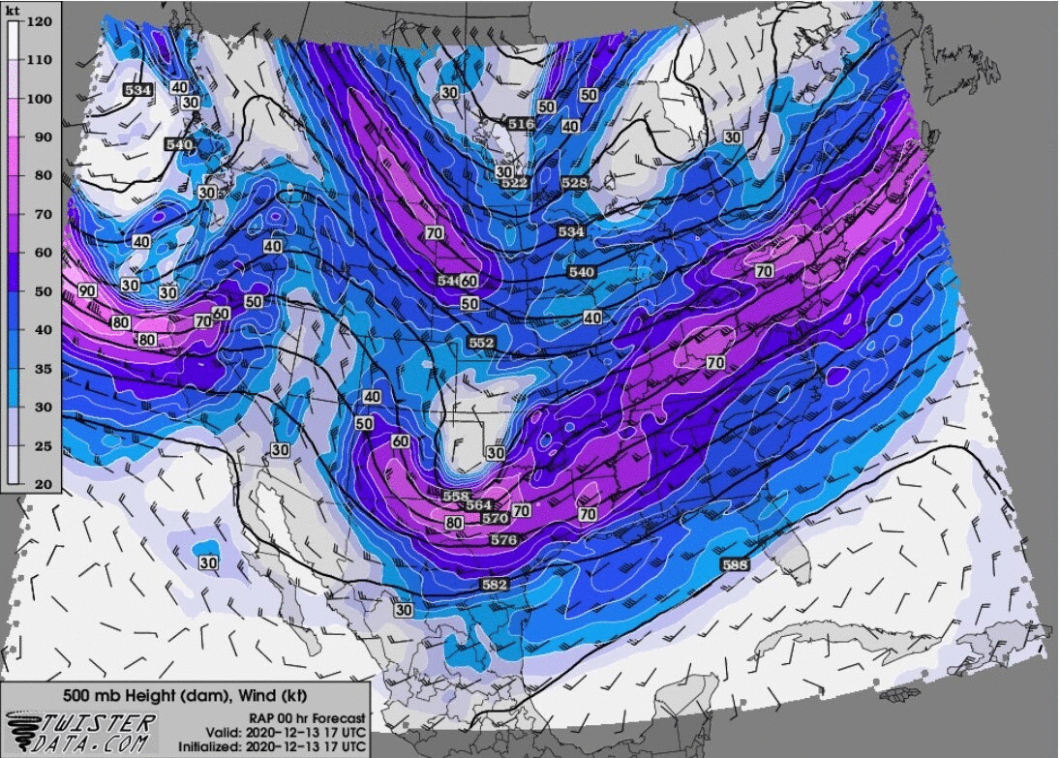
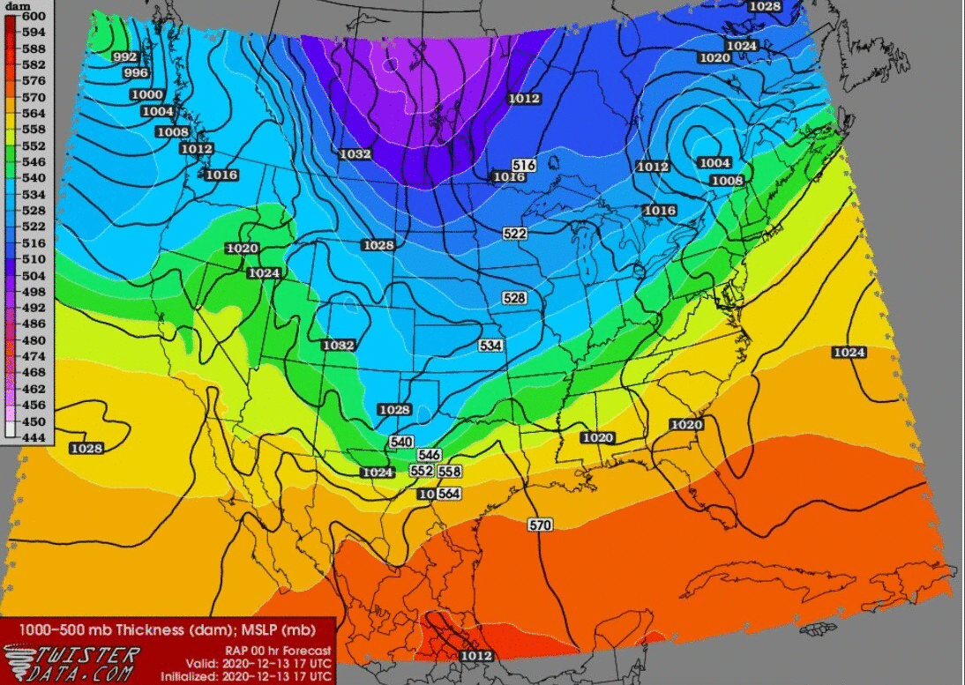
Air Masses and Weather
Although air masses form over specific locations, the air can and does move due to large-scale atmospheric wind patterns. At the same time, air masses modify the pressure gradients and the associated winds.
Wind Direction
Temperature

Slide 6
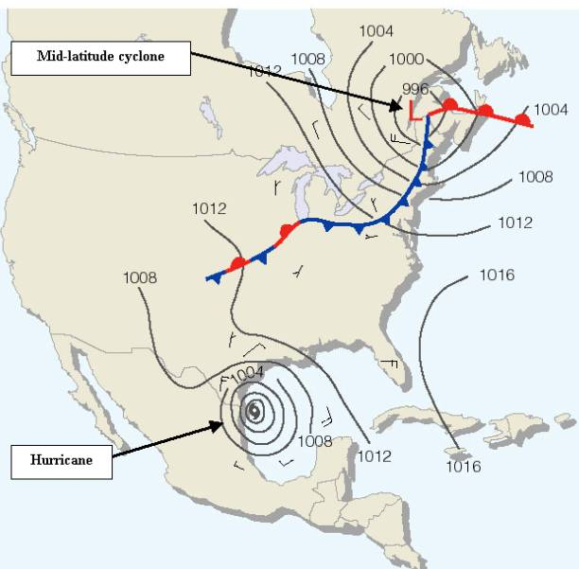
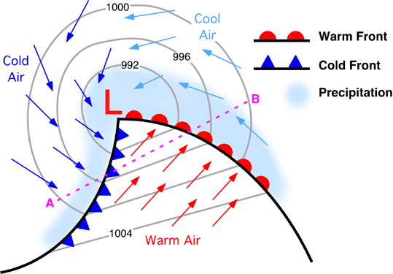
Fronts
Fronts occur along the boundaries of air masses and are named based on the temperature of the air mass that is moving.
Warm front or cold front.

